Slide 1
Laravel Framework For Beginners
By Dhairya Manish Thakkar
23000178

Slide 2
Course Objectives
Review the framework’s capabilities
Get to know the MVC concept
Initialize the web application
Review the basics of the framework
Develop a simple web application

Slide 3
What is Laravel?
Laravel is a PHP framework which is designed for building web applications which is known for its elegant syntax and features like MVC (Model-View-Controller) architecture, which separates application logic from presentation.
It provides a clean, organized structure based on the MVC (Model-View-Controller) pattern, helping developers manage code better and scale projects easily.

Slide 4
Purpose of Laravel
Laravel makes development easier by providing a clear and user-friendly syntax. It reduces the complexity of everyday tasks, allowing developers to focus more on creating unique features for their applications instead of dealing with repetitive coding.
One of Laravel’s key advantages is that it speeds up development by offering a wide range of ready-made components, libraries, and tools. These resources provide a solid base, so developers don’t have to build everything from scratch.
In short, Laravel's focus on simplicity, helpful features, and useful tools empowers developers to be more creative and work faster when building complex web applications.

Slide 5
Advantages
Scalability and Maintainability : Laravel uses the MVC (Model-View-Controller) pattern, which helps keep code organized and separates different parts of the application. This setup makes it easier to scale the app as it grows and keeps the code maintainable by keeping different modules separate and easy to manage.
Extensive Ecosystem : Laravel has a large ecosystem of extensions called Laravel Packages or Bundles that add extra features. These packages cater to a wide range of needs, from simple authentication to complex API integrations, making it easy for developers to use ready-made solutions.
Community Support and Documentation : Laravel has a lively community with active forums, helpful documentation, tutorials, and online resources. This strong support means developers can easily find answers to their questions and keep up with the latest best practices and trends.

Slide 6
Core Concepts
Routing: Routes direct user requests to specific parts of your app. These are defined in the web.php file, linking URL paths (like /about) to functions or controller methods that generate responses.
Controllers: Controllers manage the application logic and connect the data (model) to the user interface (views). They group similar actions, making the code easier to maintain.

Slide 7
Forms, Validation, and Authentication
Form Handling: Laravel makes it easy to collect and process form data, like user registrations or surveys.
Validation: Validation checks that submitted data meets specific criteria, such as proper email format or minimum password length. You can set rules in controllers to ensure data quality.
Authentication: Laravel has built-in features for secure login and registration, making sure users can only access their own data.

Slide 8
Middleware and Error Handling
Middleware: Middleware processes incoming requests, such as checking if a user is logged in before allowing access to certain pages.
Error Handling: Laravel helps catch errors and provides user-friendly error messages, making it easier to identify and fix problems without disrupting the user experience.

Slide 9
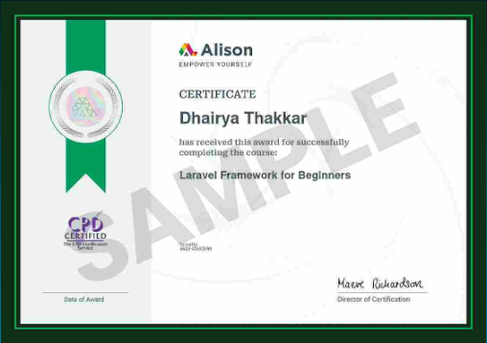

Slide 10
Thank you

